Slide 1
Predictive Analysis of Metabolic Syndrome Risk Factors
(Using Data Science Techniques)

Slide 2
Understanding Metabolic Syndrome and Its Risk Factors
Metabolic syndrome: a cluster of conditions linked to increased risk of heart disease, stroke, and type 2 diabetes.
It's closely tied to insulin resistance and associated with obesity, inactivity, and genetics. Early detection and management are vital for preventing cardiovascular diseases and diabetes.
Key risk factors include
Obesity (especially abdominal obesity)
Insulin resistance or glucose intolerance
High blood pressure
High triglyceride levels
Low HDL cholesterol levels

Slide 3
Introduction to siMS Score
The simple metabolic syndrome (siMS) score is a composite index used to assess the risk of metabolic syndrome.
It combines several key indicators related to metabolic health, providing a comprehensive measure of risk.
Uses of siMS Score:
Identifying individuals at risk of metabolic syndrome and related conditions such as heart disease and type 2 diabetes.
Monitoring changes in metabolic health over time and assessing the effectiveness of interventions such as lifestyle modifications or medications.
Allows for early intervention and management of metabolic risk factors to prevent long-term complications.

Slide 4
Data collection
This project is a continuation of the previous mid-term project.
In the previous project, patients who are at risk of metabolic syndrome were identified based on their lab values. In this project, we calculate a score to identify the severity level and analyze the relationship between different risk factors and the severity score.
New demographics such as smoking, alcohol consumption, physical activity are some of the columns that were added to this project.
The project was done using pandas, numpy, Scipy, and Matplotlib using the Jupyter Notebook
A dataset with dummy values (30 rows and 22 columns in total after merging and creating new columns using different functionalities) were made.
A total of 4 CSV files were loaded individually, cleaned, updated, and then merged to form a final dataframe called patient_final.
Using patient_final, various functionalities such as calculating BMI, siMS score, analyzing Cushing risk and a number of other statistical analysis were done.
Finally correlation analysis, T-test, Linear regression and visualizations were done for the respective variables.

Slide 5
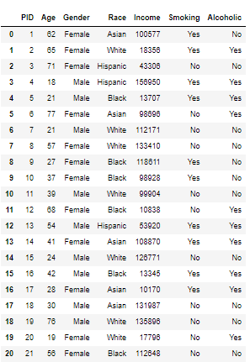
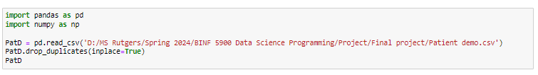
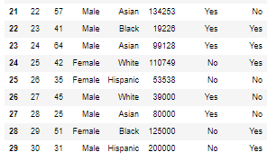
Loading the data files and performing functionalities
CSV File 1: Patient demographics
Each data file were loading one by one, duplicates were dropped and later merged with other files
Here, the first CSV file (Patient demographics with column PID, Age, Gender, Race, Income, Smoking and Alcohol history were included)
Similarly, other files were also loaded and cleaned.

Slide 6
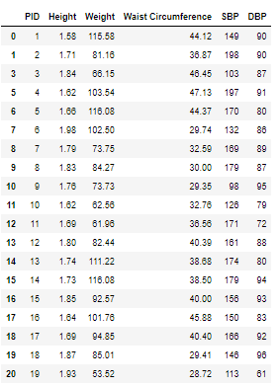
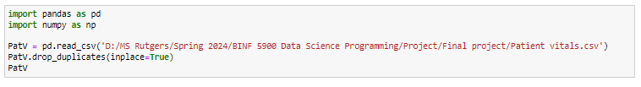
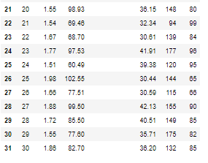
CSV File 2: Patient vitals
This file contains patient vitals such as height, weight, waist circumference, SBP, and DBP
The data file contained duplicate rows and they were removed using the drop_duplicates() function. This is the reason why there are 31 indexes in the dataframe.

Slide 7
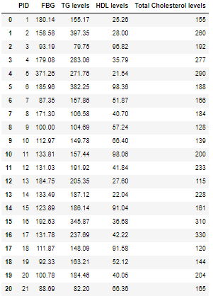
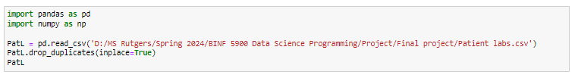
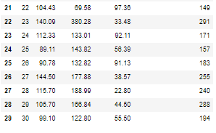
CSV File 3: Patient labs
Patient lab values were seen in this file.
Columns such as Fasting Blood glucose, TG (Triglyceride levels), HDL levels, and Total Cholesterol levels which are crucial for the prevalence of metabolic syndrome were included.

Slide 8
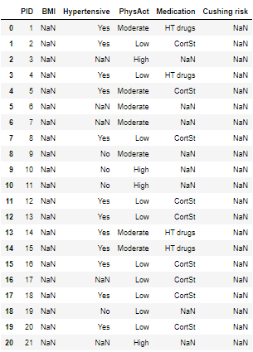

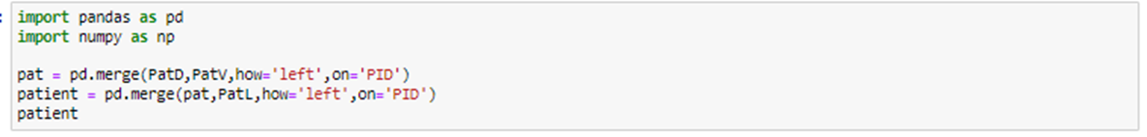
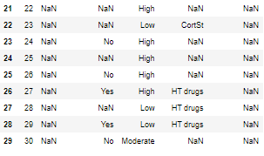
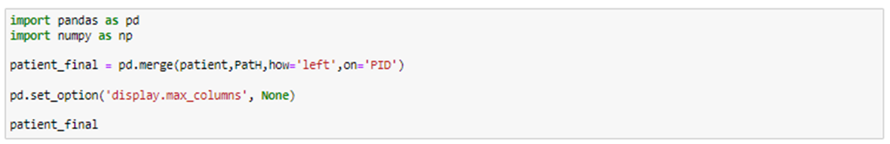
CSV File 4: Patient lifestyle habits
After loading all 4 files, we then merged them.
First PatD (Patient demographics) and PatV (Patient vitals) were merged as ‘pat’.
Then Pat was merged with the third file PatL (Patient lab) and names as ‘patient’.
Finally, patient was merged with PatH (lifestyle) and the final dataframe ‘patient_final’ was formed.

Slide 9
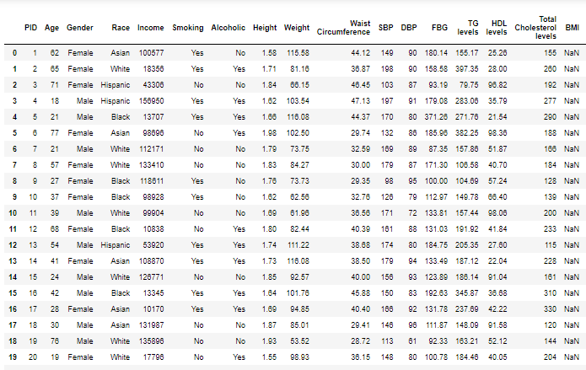
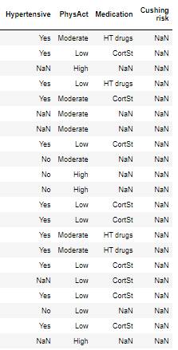
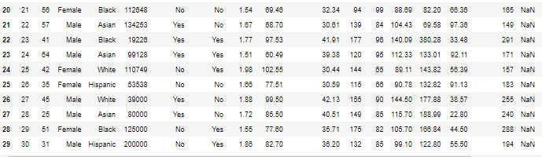
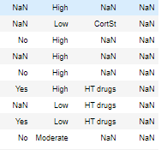
patient_final dataframe

Slide 10
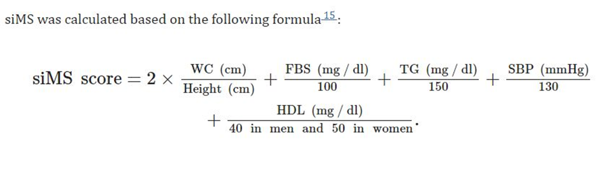
From the previous image, we can see the last few columns have ‘NaN’ values.
We use formulas and loops to calculate the values for BMI, Hypertensive, Medication, Cushing Risk, and siMS score and then append the values into the columns.
siMS score was calculated using the below formula and the values were rounded off to two decimal points.
The upcoming slides will display the code used for calculating the values and appending the output into patient_final.

Slide 11

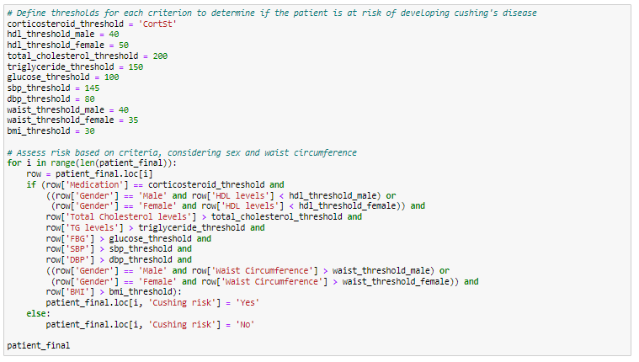

Slide 12
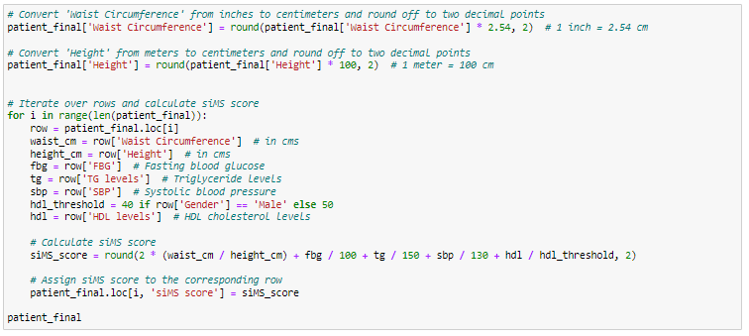
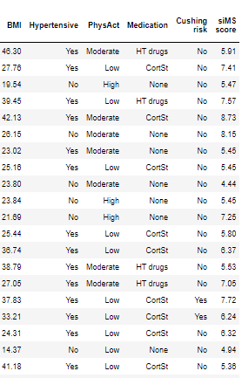
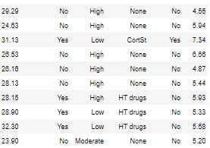
Waist circumference and Height variables were converted from inches and meters to centimeters and rounded off to two decimal points in the above code.
After appending the values, this is how the final output for the last 6 columns look like

Slide 13
Statistical analysis and objectives
Descriptive statistics for all key variables were done.
Total number of patients with a siMS score > 5.5 were counted. A siMS score of above 5.5 is considered to be high risk for developing Cardiovascular diseases, stroke, or diabetes.
Number of patients who are taking drugs to control Hypertension
Number of patients taking corticosteroids.
Patients who smoke / drink / both and are at high risk for metabolic syndrome.
An overall report was also created using the above objectives.
Furthermore, key inferences were made using advanced statistical tests such as T-test, Correlation and linear regression using scipy and pandas.

Slide 14
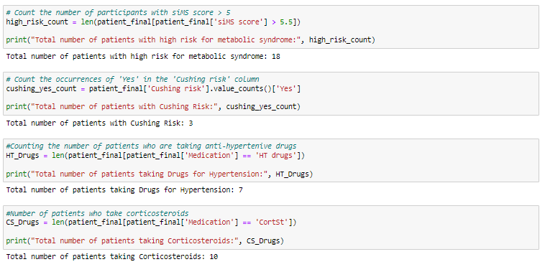
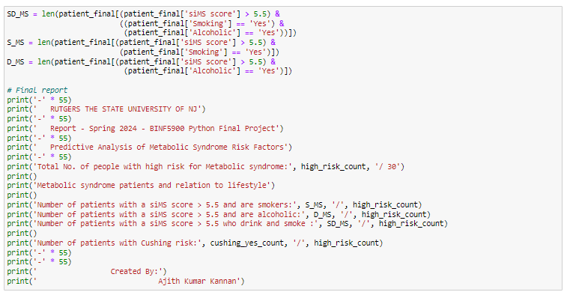
Statistical reports

Slide 15
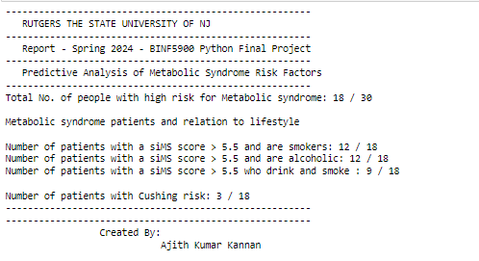
Overall report
The main purpose of this project is to analyze the relationship between various risk factors in the prevalence of Metabolic Syndrome.
A few key inferences were made based on the number of people who were at high risk for metabolic syndrome, who were at risk of developing Cushing syndrome, and the lifestyle factors influencing their medical condition.
To get a more conclusive idea of the report, we do a correlation, linear regression and t-test to see if we can see a significant difference which gives us a conclusive inference for our analysis.

Slide 16
Inferential statistics
Before running any statistical analysis, a normality check is done to see if the distribution of data is normal for the dataset we are about to run.
Next slide shows the results of the normality tests done for key numerical variables. If the variable has a p-value of > 0.05, the dataset is normal and we can move on to use the parametric statistical tests. We will use the columns Age, BMI, Waist circumference, and siMS score to run statistical tests. All three variables satisfied normality test.
Skewness and kurtosis are statistical measures that describe the shape of a distribution.
Kurtosis measures the tail heaviness of the distribution compared to a normal distribution.

Slide 17
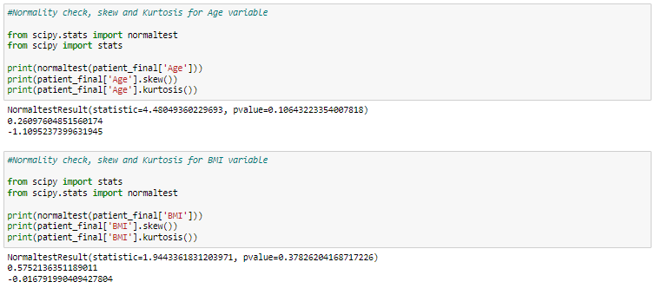
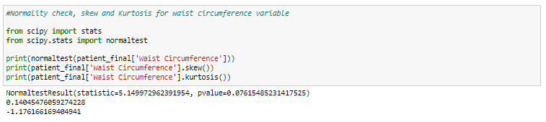
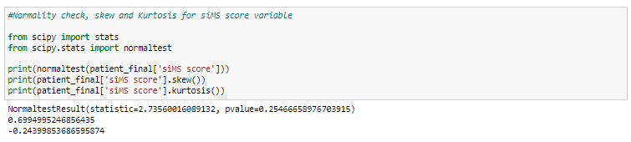

Slide 18
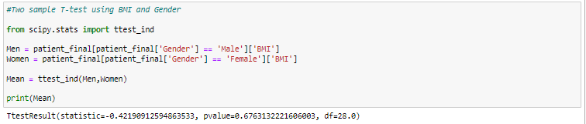
Two sample T-test (Gender and BMI)
We conducted a two sample t-test using gender and BMI to see if there is a difference in mean BMI between male and female.
Null Hypothesis (H0): There is no significant difference in the mean BMI between male and female participants.
Alternative Hypothesis (H1): There is a significant difference in the mean BMI between male and female participants.
A p-value of 0.67 suggests that there is insufficient evidence to reject the null hypothesis at the chosen significance level (e.g., α = 0.05). Therefore, based on the given p-value, we would fail to reject the null hypothesis and state that there is no significant difference in the mean BMI between male and female participants.

Slide 19
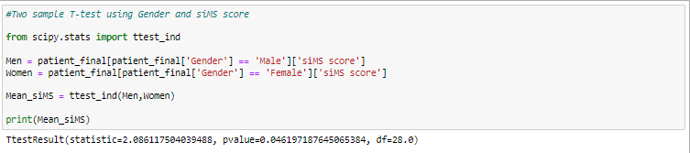
Two sample T-Test (Gender and siMS score)
We conducted a two sample t-test using gender and siMS score to see if there is a difference in mean siMS score between male and female.
Null Hypothesis (H0): There is no significant difference in the mean siMS score between male and female participants.
Alternative Hypothesis (H1): There is a significant difference in the mean siMS score between male and female participants.
A p-value of 0.04 suggests that there is sufficient evidence to reject the null hypothesis and accept the alternative hypothesis at the chosen significance level (e.g., α = 0.05). Therefore, we can say that there is a significant difference in the mean siMS score between male and female participants.

Slide 20
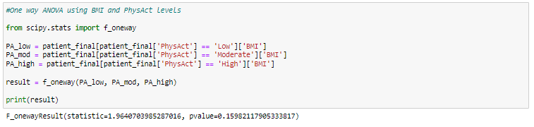
One way ANOVA (Physical Activity and BMI)
We conducted a one way ANOVA test using Physical Activity (low, moderate, and High) and BMI to see if there is a difference in mean BMI across different levels of physical activity.
Null Hypothesis (H0): There is no significant difference in the mean BMI across different levels of physical activity (low, moderate, and high).
Alternative Hypothesis (H1): There is a significant difference in the mean BMI across different levels of physical activity (low, moderate, and high).
Since the p-value (0.159) is greater than the chosen significance level (e.g., α = 0.05), we fail to reject the null hypothesis. Thus, we conclude that there is sufficient evidence to suggest there is no significant difference in the mean BMI across different levels of physical activity.

Slide 21
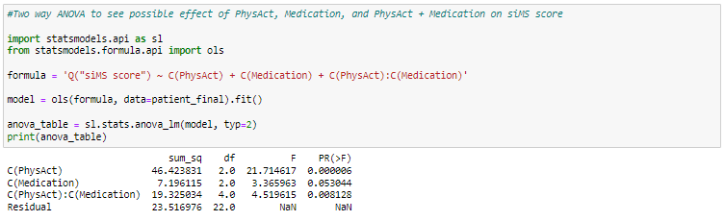
Two way ANOVA
A two way ANOVA test was done to see if there is a significant influence of risk factors or demographics such as Physical activity levels, Medication, and both on siMS score.
Hypothesis testing and results of the test are discussed in the next slide.
It is important to note that we test three sets of hypothesis for a two way ANOVA test.

Slide 22
Two way ANOVA interpretation
Null Hypothesis (H0): Physical Activity does not have a significant effect on the mean siMS score.
Alternative Hypothesis (H1): Physical Activity has a significant effect on the mean siMS score.
Null Hypothesis (H0): Medication does not have a significant effect on the mean siMS score.
Alternative Hypothesis (H1): Medication has a significant effect on the mean siMS score.
Null Hypothesis (H0): Physical Activity and Medication do not have a significant effect on the mean siMS score.
Alternative Hypothesis (H1): Physical Activity and Medication have a significant effect on the mean siMS score.
From the previous slide, we can see the p-values for all variables.
Physical activity has a significant effect on siMS score (p-value 0.00 < 0.05). So, we reject H0 and accept H1.
Medication does not show any significant impact on siMS score (p-value 0.053 > 0.05). We fail to reject H0.
Physical activity * Medication show a significant effect on siMS score (p-value 0.008 < 0.05). So, we reject H0 and accept H1.

Slide 23
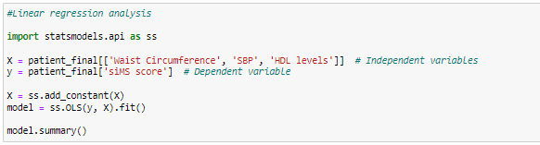
Linear regression
We do a linear regression analysis to understand the relationship between certain predictor variables and the siMS score.
The predictor variables used in the analysis include Waist Circumference, SBP (Systolic Blood Pressure), and HDL (High-Density Lipoprotein) levels. These are also called independent variables.
siMS score is our dependent variable.

Slide 24
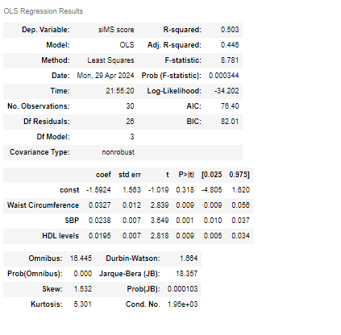
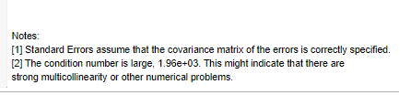
Interpreting the results of the linear regression analysis
The R-squared value of 0.503 indicates that approximately 50.3% of the variance in the siMS score can be explained by the independent variables (Waist Circumference, SBP, HDL levels) included in the model.
Overall, the results suggest that Waist Circumference, SBP, and HDL levels are statistically significant predictors of the siMS score, with positive coefficients indicating a positive association with the siMS score. However, the intercept term is not statistically significant.

Slide 25
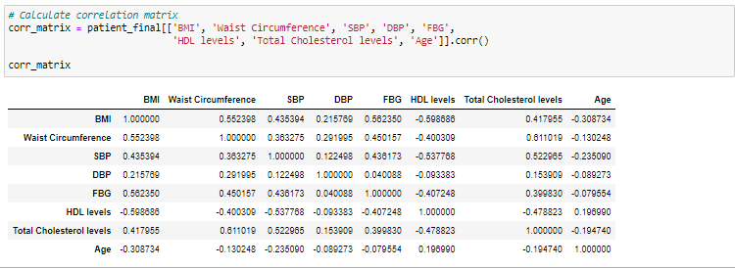
Correlation Analysis
BMI has a strong positive correlation with Waist Circumference (0.552) and FBG (0.562), and a strong negative correlation with HDL levels (-0.599).
Waist Circumference has a moderate positive correlation with Total Cholesterol levels (0.611) and a moderate negative correlation with HDL levels (-0.400).
SBP has a moderate positive correlation with Total Cholesterol levels (0.523) and a moderate negative correlation with HDL levels (-0.538).
Age has a weak negative correlation with most variables, indicating that it is not strongly associated with them.
These interpretations provide insights into the relationships between the variables included in the correlation matrix, which can guide further analysis or investigations into metabolic syndrome risk factors.

Slide 26
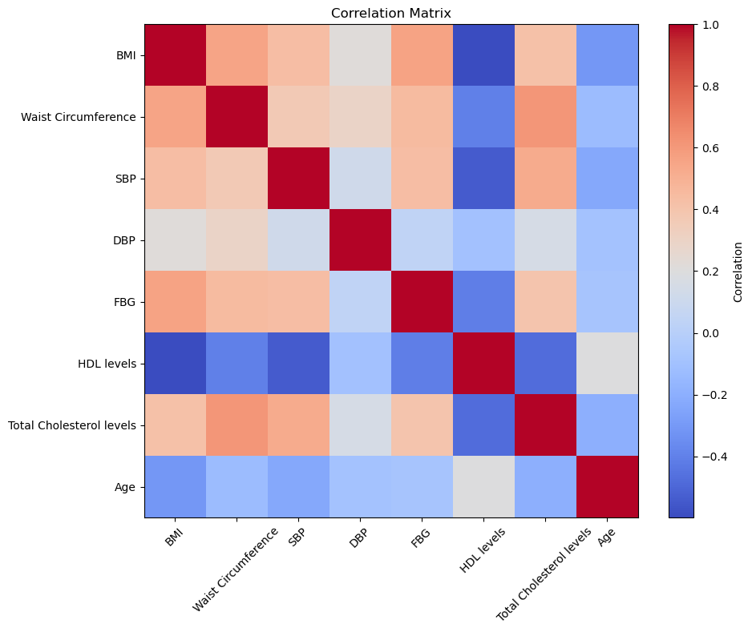
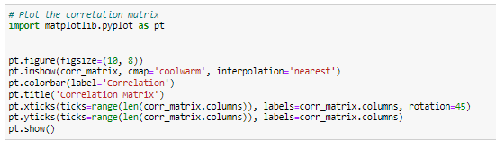
Visualizing the correlation matrix using a heat map
Each cell's color represents the strength and direction of the correlation between two variables. The cooler colors (blues) indicate negative correlations, while warmer colors (reds) indicate positive correlations.

Slide 27
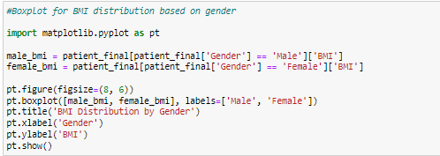
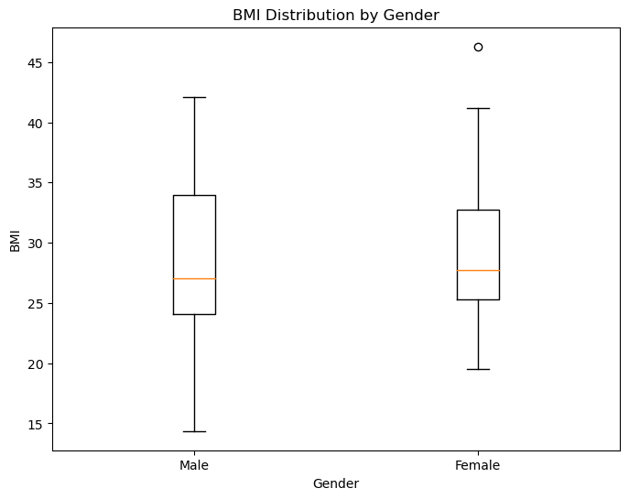
Boxplot for age distribution
The boxplot demonstrates the distribution of BMI based on Gender.
BMI distribution for males are longer than that of females.
From the boxplot, we can see there is one outlier above 45 for female. This means that particular patient’s BMI was way outside the normal average distribution between females in our dataset.

Slide 28
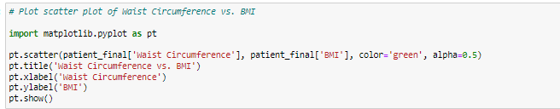
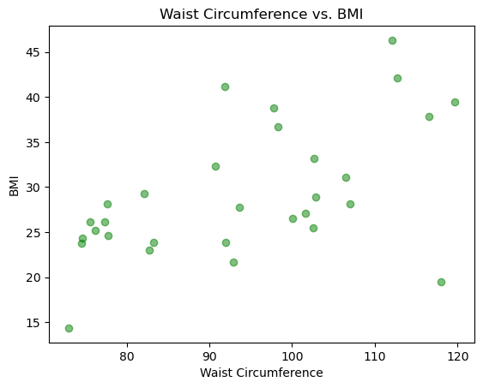
Scatterplot (Waist Circumference vs. BMI)
Scatterplots are used to visualize the distribution and correlation between two numerical variables.
Waist circumference was converted from inches to cms for siMS score calculation so it remains the same (in cms) here.
The scatter plot indicates a positive correlation between waist circumference and BMI, suggesting that as waist circumference increases, BMI tends to increase as well.

Slide 29
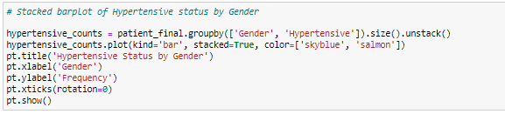
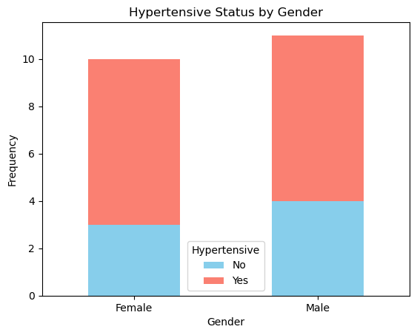
Stacked bar chart
The stacked bar chart provides a comparison of hypertensive status across genders.
The red segment represents hypertensive individuals, while the blue segment represents non-hypertensive individuals.
This visual representation can be useful for understanding the distribution of hypertensive status among different genders.

Slide 30
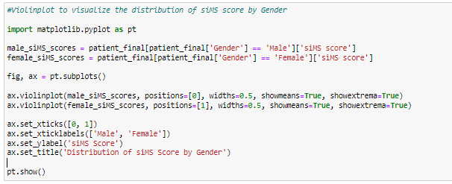
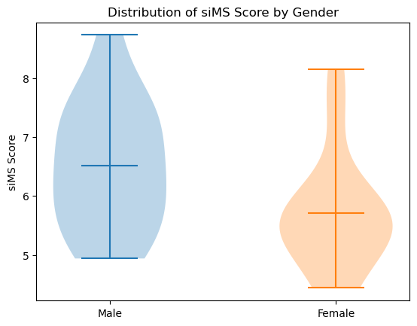
Violin plot to visualize the distribution of siMS score by Gender
The plot features two violins, one for each gender, indicating the distribution of scores among males and females.
The widest parts of the violins show where scores are most concentrated, suggesting common score ranges.
The horizontal lines within each violin likely represent the median and quartiles, providing a summary of the data’s spread.

Slide 31
Conclusion
Through this predictive analysis of metabolic syndrome risk factors project, we have gained valuable insights into the relationships between various demographic and health-related variables.
Our findings suggest that factors such as BMI, waist circumference, blood pressure, TG levels, and HDL levels play significant roles in determining the risk of metabolic syndrome.
By leveraging statistical methods such as correlation analysis, linear regression, and hypothesis testing, we have identified key predictors of metabolic syndrome and their impact on overall health outcomes.
Overall, the project underscores the importance of early detection and intervention strategies to mitigate the risk of metabolic syndrome and improve health outcomes for individuals.

Slide 32
References
Kaggle.com (https://www.kaggle.com/code/tanshihjen/eda-classification-metabolicsyndrome)
Motamed, N., Ajdarkosh, H., Karbalaie Niya, M. H., Panahi, M., Farahani, B., Rezaie, N., Nikkhah, M., Faraji, A. H., Hemmasi, G., Perumal, D., Ashrafi, G. H., Safarnezhad Tameshkel, F., Gholizadeh, E., Khoonsari, M., & Zamani, F. (2022). Scoring systems of metabolic syndrome and prediction of cardiovascular events: A population based cohort study. Clinical cardiology, 45(6), 641–649. https://doi.org/10.1002/clc.23827
Soldatovic, I., Vukovic, R., Culafic, D., Gajic, M., & Dimitrijevic-Sreckovic, V. (2016). siMS Score: Simple Method for Quantifying Metabolic Syndrome. PloS one, 11(1), e0146143. https://doi.org/10.1371/journal.pone.0146143
BINF 5900 Lecture notes and Assignments.
Created and Compiled by:
Ajith Kumar Kannan

Slide 33


